Slide 1
Relationship in ER-Model

Slide 2
Cardinalitity Ratio
Participation constraints
Structural constraints
Attributes for relationship types
Recursive relationship & role name
Weak entity set
ER diagram
Ternary relationship

Slide 3
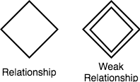
Relationship between entities

Slide 4
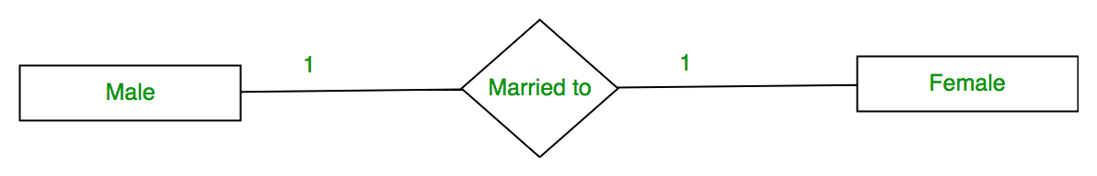
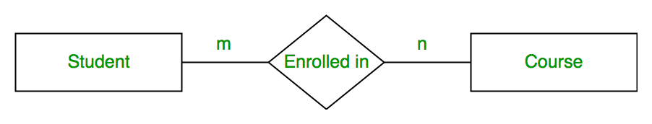
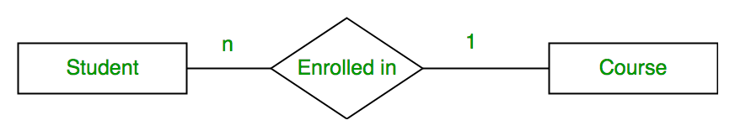
ER Diagram: Relationship
The Relationship may:
One to One
One to Many
Many to Many
Many to One
1
Teaches
n
Subjects
Professor

Slide 5
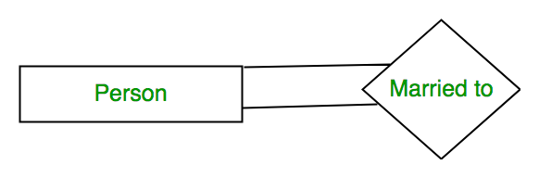
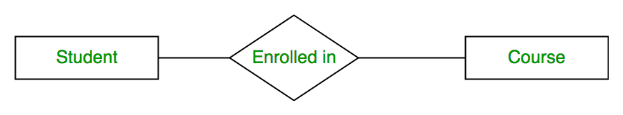
Degree of Relationship
Unary Relationship
Relationship among one entity set.
Binary Relationship
Relationship among two entities set.
Ternary Relationship
Relationship among 3 entities set.
N-ary Relationship :
Relationship between n number of entities set.
Teaches
Professor
Courses
Semester

Slide 6
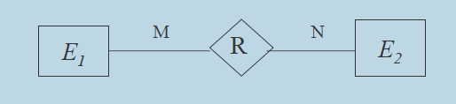
Binary Relationship and Cardinality ratio

Slide 7
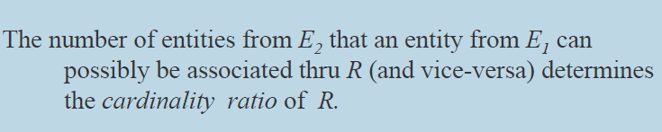
Binary Relationship and Cardinality ratio

Slide 8
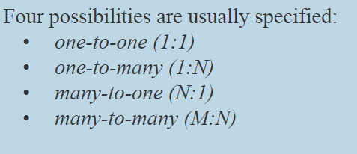
Binary Relationship and Cardinality ratio

Slide 9
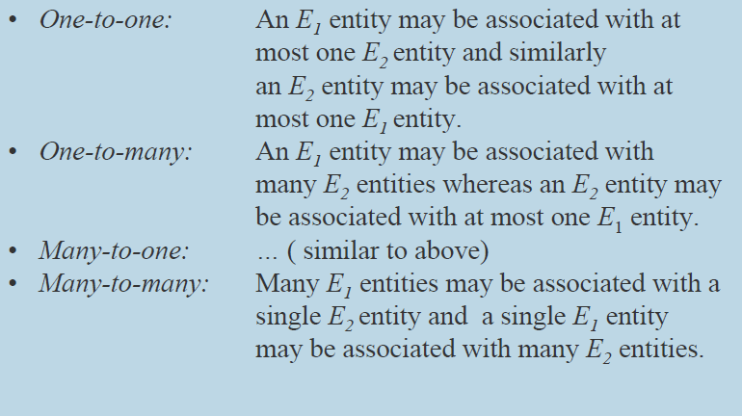
Binary Relationship and Cardinality ratio

Slide 10
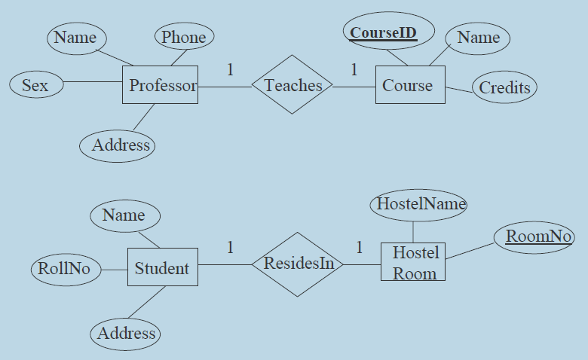
Binary Relationship and Cardinality ratio- Examples

Slide 11
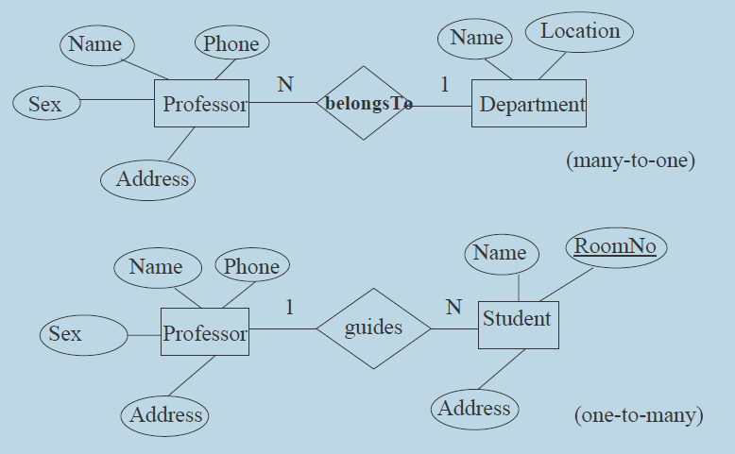
Binary Relationship and Cardinality ratio- Examples

Slide 12
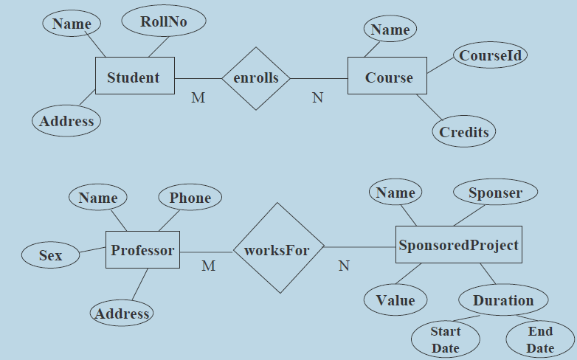
Binary Relationship and Cardinality ratio- Examples

Slide 13
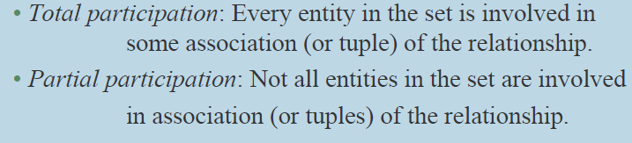
Participation constraints
An entity set may participate in a relation either totally or partially

Slide 14
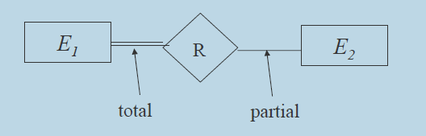
Participation constraints

Slide 15
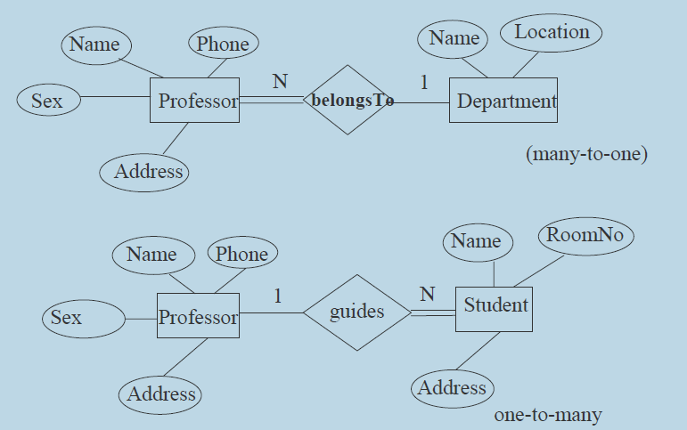
Participation constraints Examples

Slide 16


Structural Constraints

Slide 17
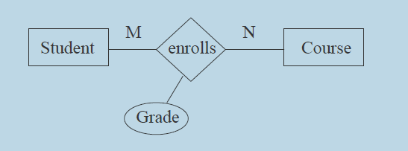

Attributes for relationship types
Properties of the association of entities

Slide 18
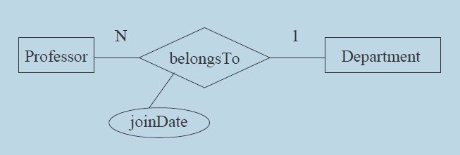
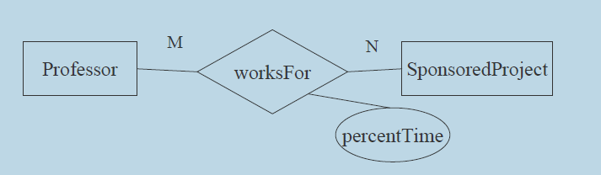
Attributes for relationship types-Examples

Slide 19
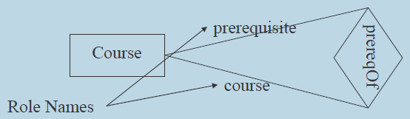
Recursive Relationship & Role Name
An entity set relating to itself.
Role name is used to specify the exact role in which the entity participate in the relationship

Slide 20
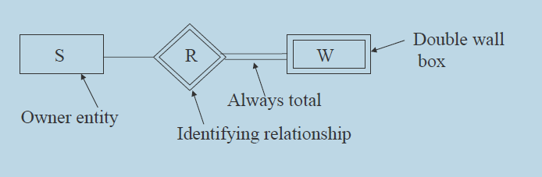
Weak Entity set

Slide 21
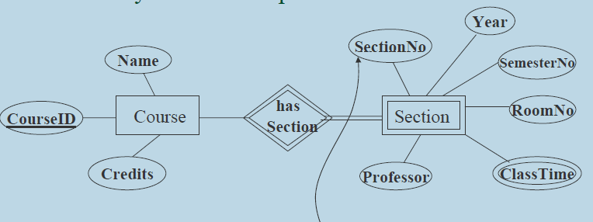
Weak Entity set

Slide 22
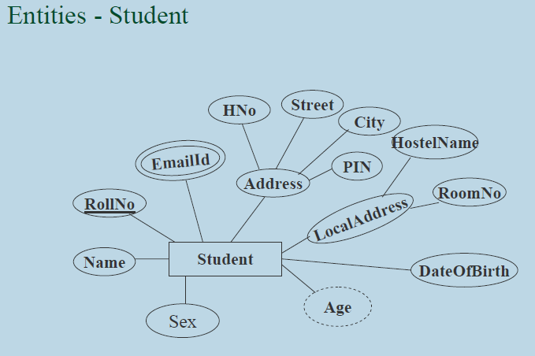
ER Diagram

Slide 23
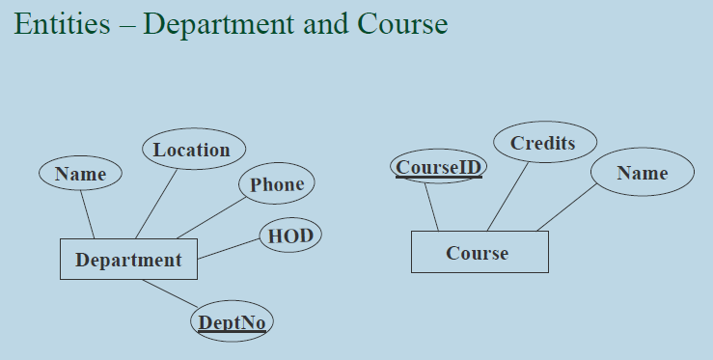
ER Diagram

Slide 24
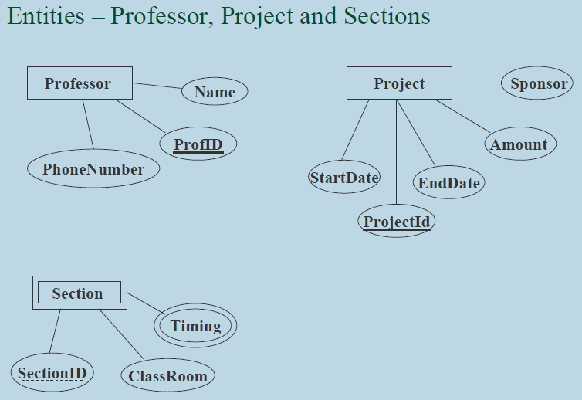
ER Diagram

Slide 25
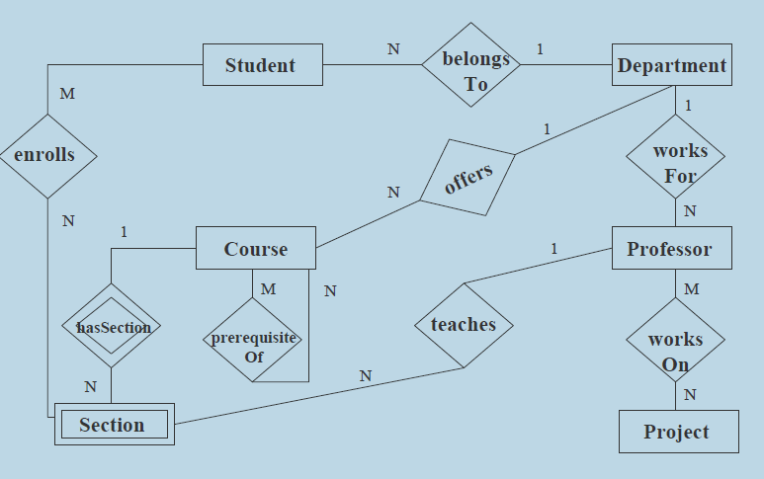
ER Diagram

Slide 26
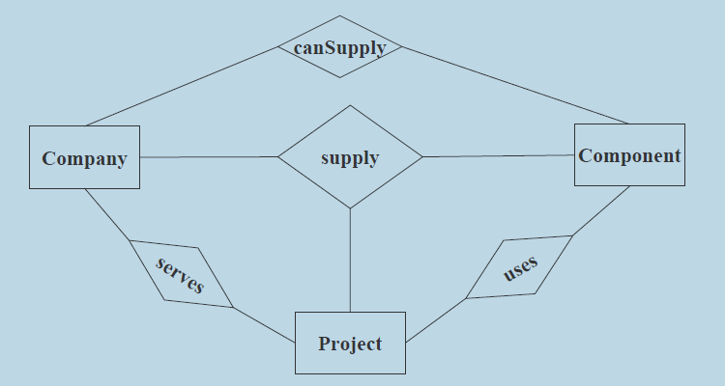
Ternary Relationship

Slide 27
Flight Database Example
The flight database stores details about an airline’s fleet, flights, and seat bookings. Again, it’s a hugely simplified version of what a real airline would use, but the principles are the same.
Consider the following requirements list:
The airline has one or more airplanes.
An airplane has a model number, a unique registration number, and the capacity to take one or more passengers.
An airplane flight has a unique flight number, a departure airport, a destination airport, a departure date and time, and an arrival date and time.
Each flight is carried out by a single airplane.
A passenger has given names, a surname, and a unique email address.
A passenger can book a seat on a flight.

Slide 28
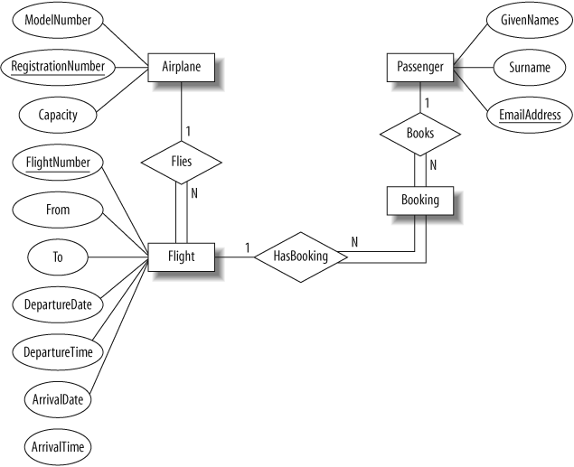

Slide 29
An Airplane is uniquely identified by its RegistrationNumber, so we use this as the primary key.
A Flight is uniquely identified by its FlightNumber, so we use the flight number as the primary key. The departure and destination airports are captured in the From and To attributes, and we have separate attributes for the departure and arrival date and time.
Because no two passengers will share an email address, we can use the EmailAddress as the primary key for the Passenger entity.
An airplane can be involved in any number of flights, while each flight uses exactly one airplane, so the Flies relationship between the Airplane and Flight relationships has cardinality 1:N; because a flight cannot exist without an airplane, the Flight entity participates totally in this relationship.
A passenger can book any number of flights, while a flight can be booked by any number of passengers. As discussed earlier in Intermediate Entities,” we could specify an M:N Books relationship between the Passenger and Flight relationship, but considering the issue more carefully shows that there is a hidden entity here: the booking itself. We capture this by creating the intermediate entity Booking and 1:N relationships between it and the Passenger and Flight entities. Identifying such entities allows us to get a better picture of the requirements.

Slide 30
The University Database
The university database stores details about university students, courses, the semester a student took a particular course (and his mark and grade if he completed it), and what degree program each student is enrolled in. The database is a long way from one that’d be suitable for a large tertiary institution.
Consider the following requirements list:
The university offers one or more programs.
A program is made up of one or more courses.
A student must enroll in a program.
A student takes the courses that are part of her program.
A program has a name, a program identifier, the total credit points required to graduate, and the year it commenced.
A course has a name, a course identifier, a credit point value, and the year it commenced.
Students have one or more given names, a surname, a student identifier, a date of birth, and the year they first enrolled. We can treat all given names as a single object—for example, “John Paul.”
When a student takes a course, the year and semester he attempted it are recorded. When he finishes the course, a grade (such as A or B) and a mark (such as 60 percent) are recorded.
Each course in a program is sequenced into a year (for example, year 1) and a semester (for example, semester 1).

Slide 31
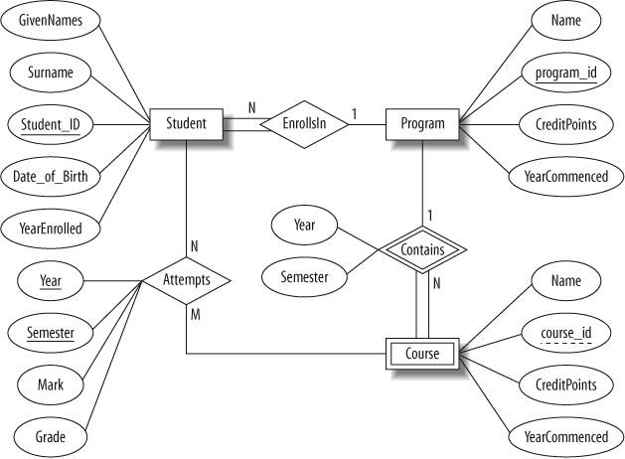

Slide 32
In this design:
Student is a strong entity, with an identifier, student_id, created to be the primary key used to distinguish between students (remember, we could have several students with the same name).
Program is a strong entity, with the identifier program_id as the primary key used to distinguish between programs.
Each student must be enrolled in a program, so the Student entity participates totally in the many-to-one EnrollsIn relationship with Program. A program can exist without having any enrolled students, so it participates partially in this relationship.
A Course has meaning only in the context of a Program, so it’s a weak entity, with course_id as a weak key. This means that a Course is uniquely identified using its course_id and the program_id of its owning program.
As a weak entity, Course participates totally in the many-to-one identifying relationship with its owning Program. This relationship has Year and Semester attributes that identify its sequence position.
Student and Course are related through the many-to-many Attempts relationships; a course can exist without a student, and a student can be enrolled without attempting any courses, so the participation is not total.
When a student attempts a course, there are attributes to capture the Year and Semester, and the Mark and Grade.

Slide 33
The Music Database
The music database stores details of a personal music library, and could be used to manage your MP3, CD, or vinyl collection. Because this database is for a personal collection, it’s relatively simple and stores only the relationships between artists, albums, and tracks. It ignores the requirements of many music genres, making it most useful for storing popular music and less useful for storing jazz or classical music.
We first draw up a clear list of requirements for our database:
The collection consists of albums.
An album is made by exactly one artist.
An artist makes one or more albums.
An album contains one or more tracks
Artists, albums, and tracks each have a name.
Each track is on exactly one album.
Each track has a time length, measured in seconds.
When a track is played, the date and time the playback began (to the nearest second) should be recorded; this is used for reporting when a track was last played, as well as the number of times music by an artist, from an album, or a track has been played.

Slide 34
There’s no requirement to capture composers, group members or sidemen, recording date or location, the source media, or any other details of artists, albums, or tracks.
It consists of only one-to-many relationships: one artist can make many albums, one album can contain many tracks, and one track can be played many times.
Conversely, each play is associated with one track, a track is on one album, and an album is by one artist.
The attributes are straightforward: artists, albums, and tracks have names, as well as identifiers to uniquely identify each entity.
The track entity has a time attribute to store the duration, and the played entity has a timestamp to store when the track was played.

Slide 35
